Slide 1
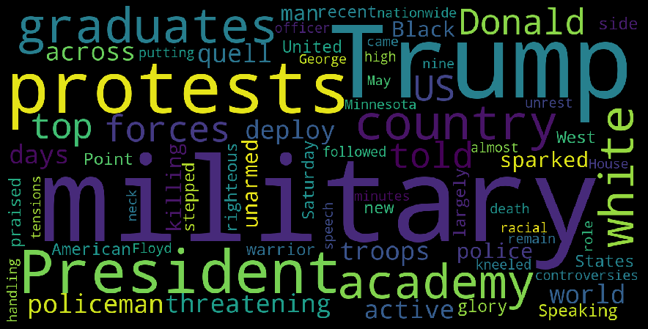
Extractive Text Summarization
Faisal Riaz F2019313020
Waseem Abbas F2019313001

Slide 2
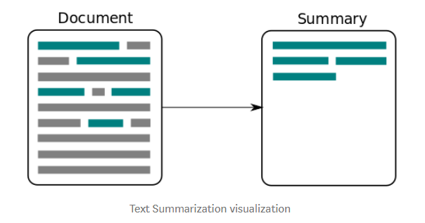
Text Summarization
The technique for generating a concise and precise summary texts without losing the overall meaning.
Transform lengthy documents into shortened versions.
Machine learning algorithms can be trained to comprehend documents and identify the sections that convey important facts and information before retrieving the required summarized texts.
Text summarization methods are greatly needed to address the ever-growing amount of text data available online.

Slide 3
Extractive Summarization
The extractive text summarization technique involves pulling key phrases from the source.
Generation summary with pulled key phrases and sentences.
No change is performed in the extracted text.
Here is an example:
Source text: Joseph and Mary rode on a donkey to attend the annual event in Jerusalem. In the city, Mary gave birth to a child named Jesus.
Extractive summary: Joseph and Mary attend event Jerusalem. Mary birth Jesus.
As you can see above, the words in bold have been extracted and joined to create a summary — although sometimes the summary can be grammatically strange.

Slide 4
Abstractive Summarization
This technique entails paraphrasing and shortening parts of the source document.
It can overcome the grammar inconsistencies of the extractive method.
Algorithms create new phrases and sentences from the original text — just like humans do.
Therefore, abstraction performs better than extraction.
Algorithms required to do abstraction are more difficult to develop, that’s why the use of extraction is still popular.
Here is an example: Joseph and Mary rode on a donkey to attend the annual event in Jerusalem. In the city, Mary gave birth to a child named Jesus.
Abstractive summary: Joseph and Mary came to Jerusalem where Jesus was born.

Slide 5
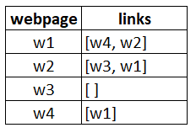
Text Rank Algorithm
Text Rank is based on Page Rank Algorithm.
We will briefly explain Page Rank and later will develop analogy with Text Rank.
4 web pages — w1, w2, w3, and w4. These pages contain
Links pointing to one another.
Web page w1 has links directing to w2 and w4.
w2 has links for w3 and w1.
w4 has links only for the web page w1.
w3 has no links and hence it will be called a dangling page.

Slide 6
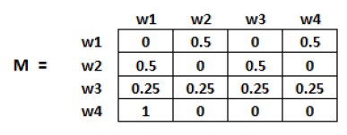

Text Rank Algorithm cont..
PageRank score is the probability of a user visiting that page.
Create a Transition Matrix for N number of pages M = NxN , which contains the transitions probabilities of navigation from one page to another.
Each element of this matrix denotes the probability.
Probability of going from page i to j, i.e., M[ i ][ j ], is initialized with 1/(number of unique links in web page W_{i})
If no link between the page i and j, then the probability will be initialized with 0
If dangling page, then it is assumed that it is equally likely to transition to any page. Hence, M[ i ][ j ] will be initialized with 1/(number of web pages)

Slide 7
Text Rank Analogy with Page Rank
In place of web pages, we use sentences.
Similarity between any two sentences is used as an equivalent to the web page transition probability.
The similarity scores are stored in a square matrix, similar to the matrix M used for PageRank.
Sentence similarity matrix is used to rank sentences.

Slide 8
Text Rank Algorithm
Graph-based model
For graphs extracted from texts
Two tasks (Keyword extraction , Sentence extraction)
The Score of Graph
Starting from arbitrary values
The computation iterates
Until convergence below a given threshold is achieved
The Score of vertex
Importance of the vertex
The final values are not affected by the initial value
Only the number of iterations to convergence may be different

Slide 9
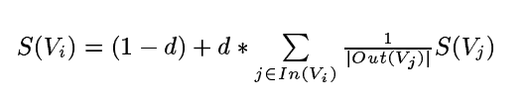

Text Rank Model
Score of the Vertex
$S\left(Vi\right)$ :the score of the vertex.
$Vi$ :is the vertex
$In(Vi$) :no of vertices that point to it.
$Out(Vj$) :no of vertices that vertex point to.
$d$ :the damping factor (0.85)

Slide 10
Text As Graph
4 steps of Graph-based ranking algorithms
Identify text units
Best define the task at hand and add them as vertices in the graph
Identify relations
Connect such text units
Use these relations to draw edges
Directed and Undirected
Iterate the graph-based ranking algorithm
Until convergence
Sort vertices based on their final score

Slide 11
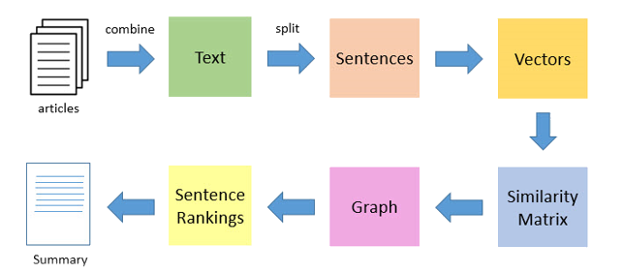
Text Summarizer Workflow

Slide 12
Text Summarizer Workflow
Selecting and article from a dataset and extracting all the text.
Splitting the Text into sentences.
Converting all the words in a sentence to vectors.
Generating similarity matrix across sentences from their vectors.
Similarity matrix is then converted into graph, where sentences are the Nodes/Vertices and the scores as edges to calculate sentence rank.
Graph for all the sentences is drawn.
Sentences ranks are sorted in descending order.
N numbers of top ranked sentences are selected to generate summarized text.

Slide 13
Count Vectorizer
“He is playing in the field. He is running towards the football. The football game ended. It started raining while everyone was playing in the field.”
Unique List = ['ended', 'everyone', 'field', 'football', 'game', 'he', 'in', 'is', 'it', 'playing', 'raining', 'running', 'started', 'the', 'towards', 'was', 'while']
Vector1 = [0, 0, 0, 0, 0, 0, 0, 0, 0, 0, 0, 0, 0, 0, 0, 0, 0].
Let’s take the first sentence, He is playing in the field.
The first word is He. Its position is 6th from the starting (Unique List). I’ll just update its vector and it will now be:
Vector1 =[0, 0, 0, 0, 0, 1, 0, 0, 0, 0, 0, 0, 0, 0, 0, 0, 0].
Similarly, we will find each word from the Unique List is searched and its respective index is updated (0+1) in the Vector1. Complete representation of He is playing in the field would become as:
Vector1 =[0, 0, 1, 0, 0, 1, 1, 1, 0, 1, 0, 0, 0, 1, 0, 0, 0].

Slide 14
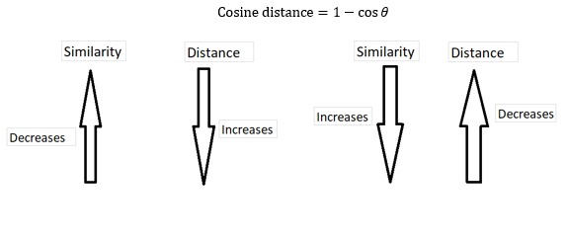
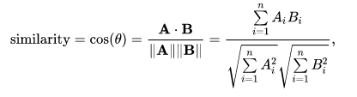
Cosine Distance /Cosine Similarity
Cosine similarity is used to determine the similarity between documents, sentences or vectors. Mathematically, it measures the cosine of the angle between two vectors projected in a multi-dimensional space.

Slide 15
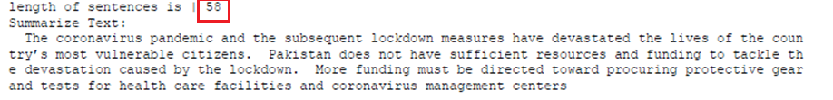
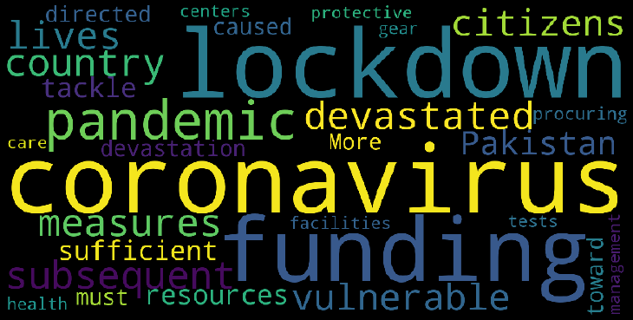
Results
Summary of an article is shown as the top 3 sentences with word cloud.

Slide 16
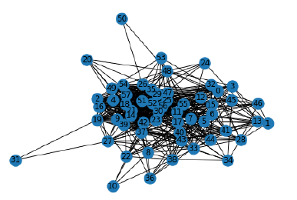
Results
Graph is generated for 58 sentences Article as shown below

Slide 17


